Slide 1


Homepage Special Offers Carousel: Merchandising Test Results
An analysis of our recent UX experiment testing a rotating carousel for bundle promotion versus the existing Wild Willy planner layout.
by Andre Rand

Slide 2
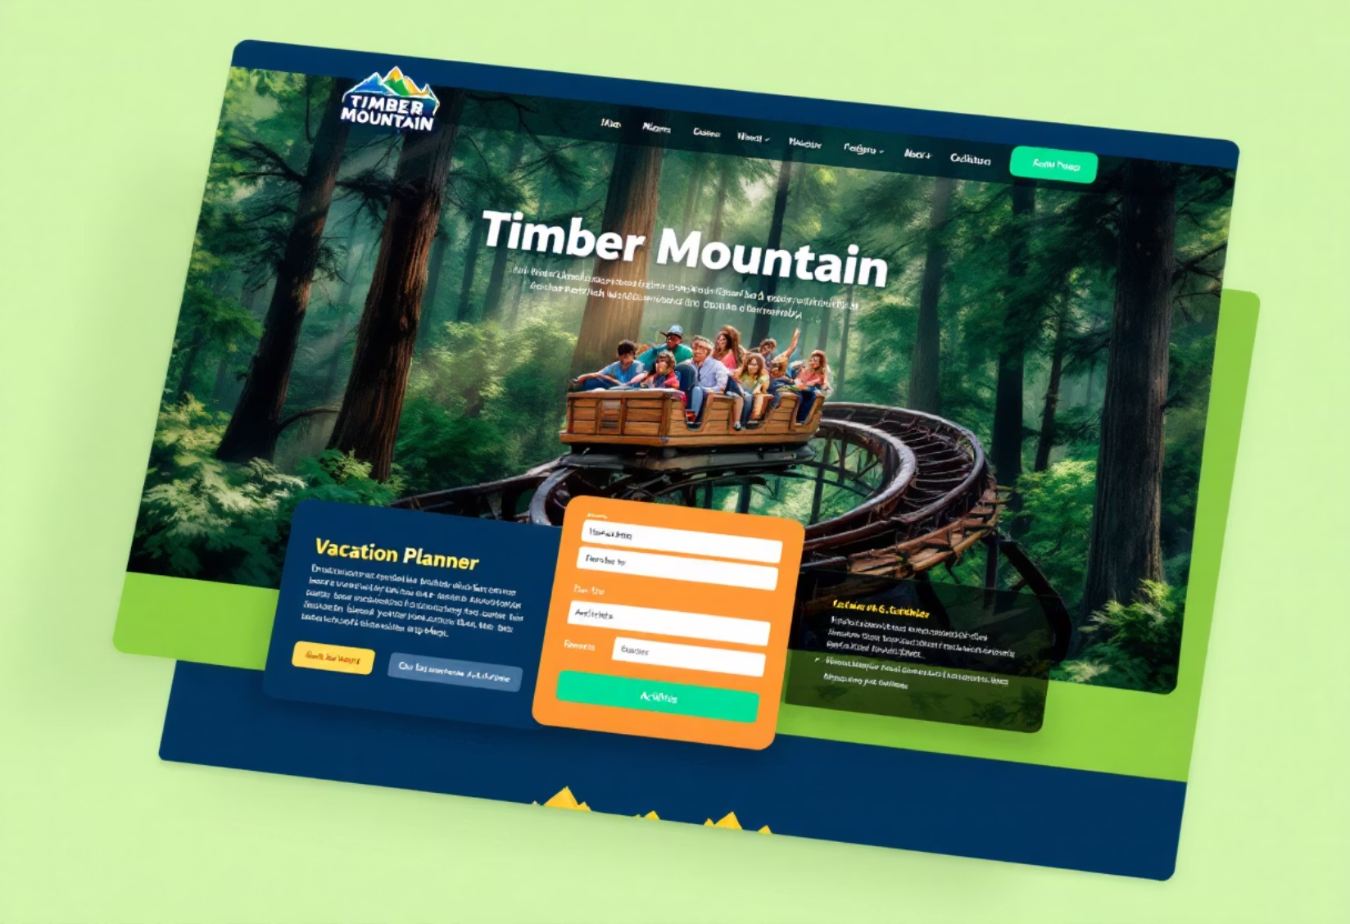
Background & Current State
Timber Mountain's ticket bundles combining park admission, hotel stays, and express passes generate 22% of our annual revenue. However, these high-value offerings suffer from low visibility on our homepage.
Currently, bundle discovery options are positioned well below the fold, requiring significant scrolling from visitors, potentially limiting their exposure and subsequent conversion rates.
The Wild Willy planner module currently occupies prime real estate directly beneath the hero section, serving as the primary entry point for trip planning.
The current homepage places the Wild Willy planner immediately below the hero image, with bundle options requiring additional scrolling to discover.

Slide 3
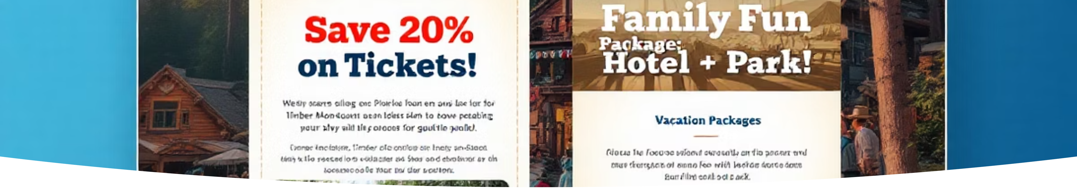
The Proposed Solution
Rotating Carousel
Strategic Placement
Potential Risk
The product team proposed introducing a "Special Offers" carousel directly under the hero section, designed to showcase time-boxed deals and bundle offerings with greater visibility.
By positioning limited-time offers at the top of the fold, we aimed to increase awareness and drive faster add-to-cart actions for these high-margin products.
The primary concern was displacement of the popular Wild Willy planner module, pushing it below the fold and potentially reducing engagement with this critical conversion path.

Slide 4
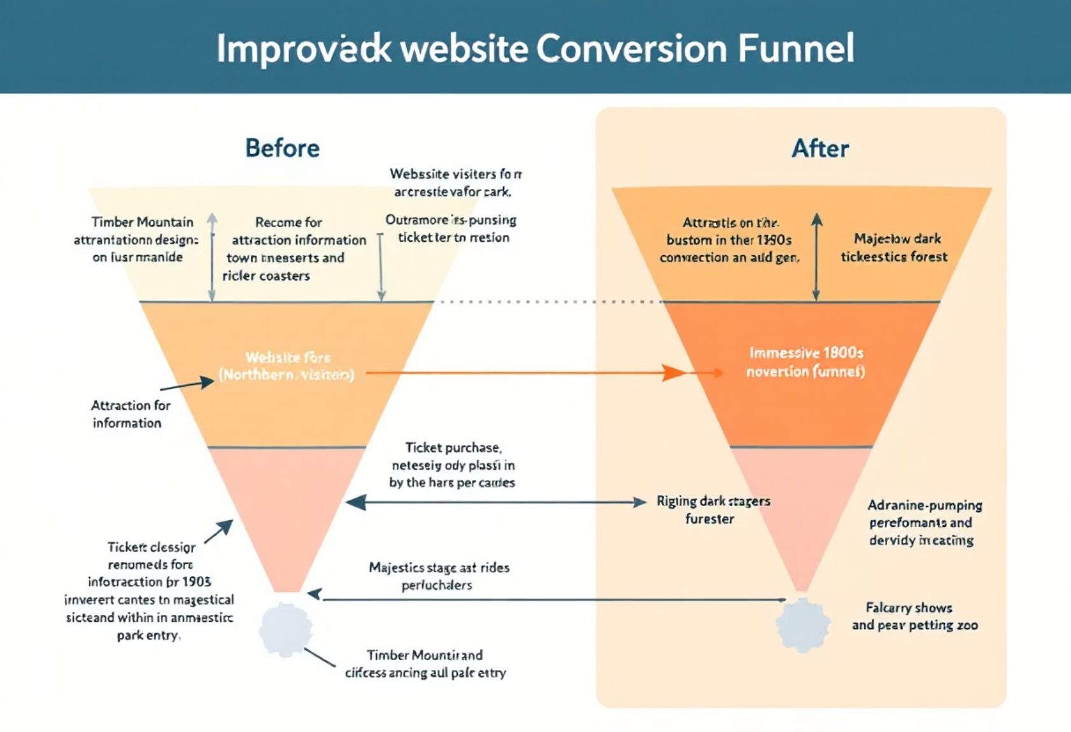
Our Test Hypothesis
Surfacing limited-time bundle offers in a top-of-fold rotating carousel will raise the add-to-cart rate by at least 7% among first-time U.S. visitors.
Key Assumptions
Increased visibility of bundle offers would outweigh the shift of the planner below the fold
Motion and rotation would attract attention to special offers
Time-limited deals would create urgency and drive faster conversion
Our hypothesis suggested that higher visibility of time-sensitive offers would overcome any potential friction from repositioning the Wild Willy planner module.

Slide 5
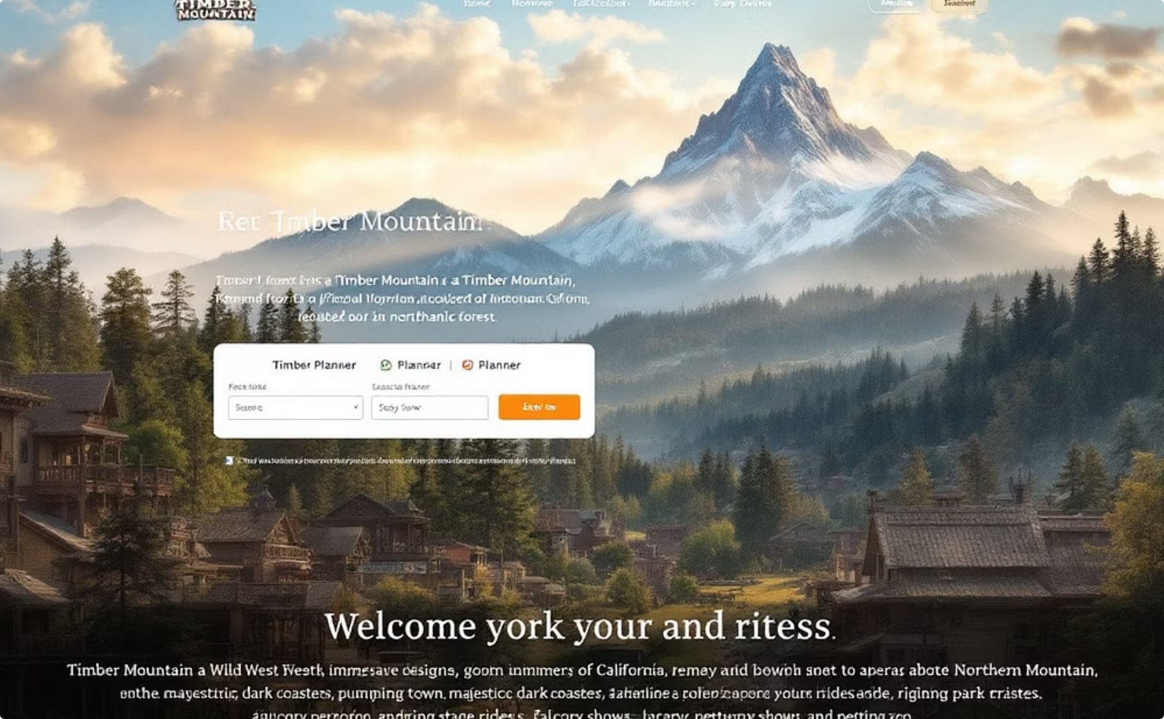
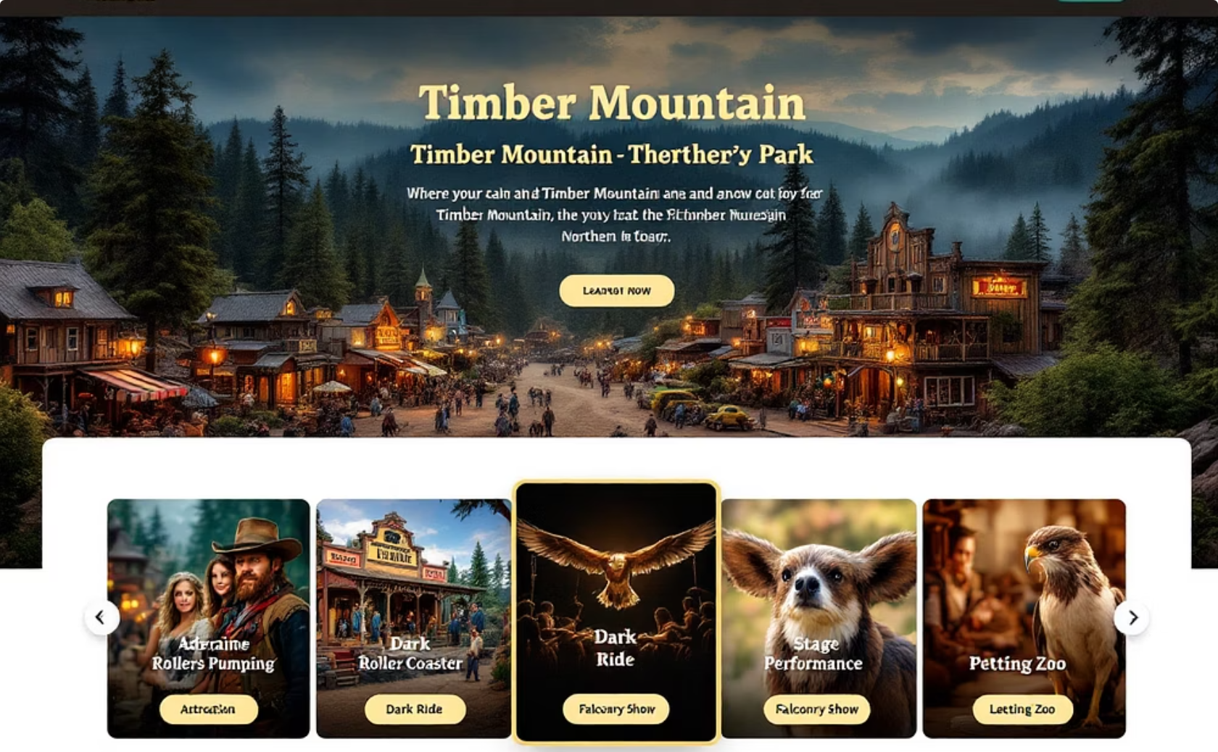
Test Design: Control vs. Treatment
Control Layout
Treatment Layout
Hero image → Wild Willy planner module → static promo banner positioned lower on the page
Hero image → Special Offers carousel (4 rotating cards, 6-sec auto-advance) → Wild Willy shifted below the fold

Slide 6

Technical Implementation
Carousel Specifications
Built with native CSS scroll snap and JavaScript auto-scroll functionality
Optimized with lazy-loading for the second frame to minimize performance impact
Automatic advancement every 6 seconds with pause on hover
Responsive design adapting to all viewport sizes
Fallback to Control version for users with JavaScript disabled (< 0.2% of sessions)
The development team implemented the carousel using modern web standards to ensure optimal performance while maintaining accessibility and graceful degradation.

Slide 7
Test Methodology
Geo
United States
Audience
First-time visitors (no Timber Mountain cookie)
Test Period
November 4, 2024 — November 24, 2024
Traffic Split
50/50 at session start
Primary KPI
Add-to-cart rate (any item)
Secondary Metrics
Wild Willy planner starts, Scroll-depth, Time-on-page
Guardrails
Bounce rate, 95th-percentile First Contentful Paint
Statistical Analysis
Two-tailed z-test, α = 0.05 (≥ 95% power to detect ±7% effect)

Slide 8
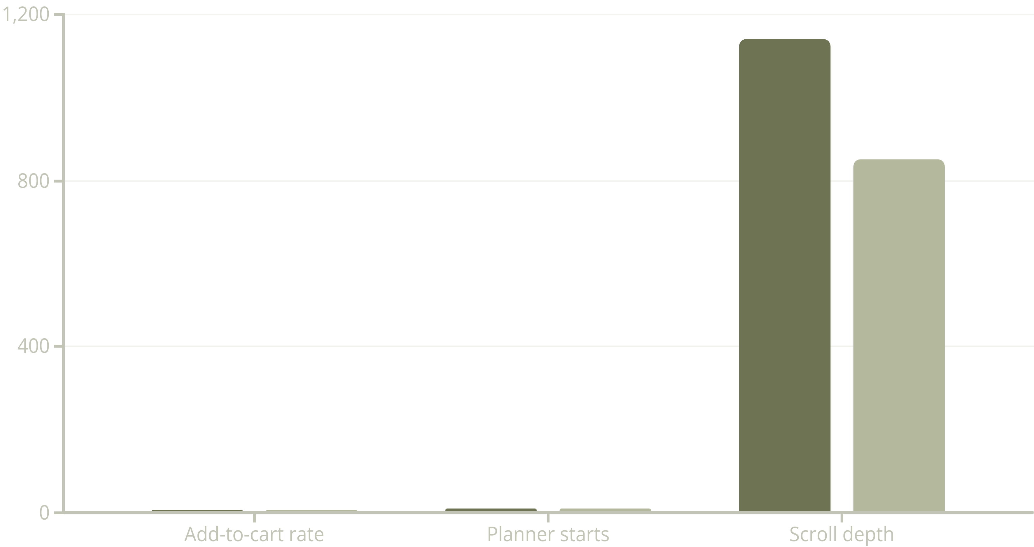
Test Results
Control
Carousel (Treatment)
The carousel underperformed significantly, with a statistically significant 4.5% drop in add-to-cart rate (p-value: 0.040) and an 18% reduction in Wild Willy planner starts (p-value: 0.012). Page performance metrics remained stable with only a negligible 1.1% increase in First Contentful Paint (p-value: 0.68).

Slide 9
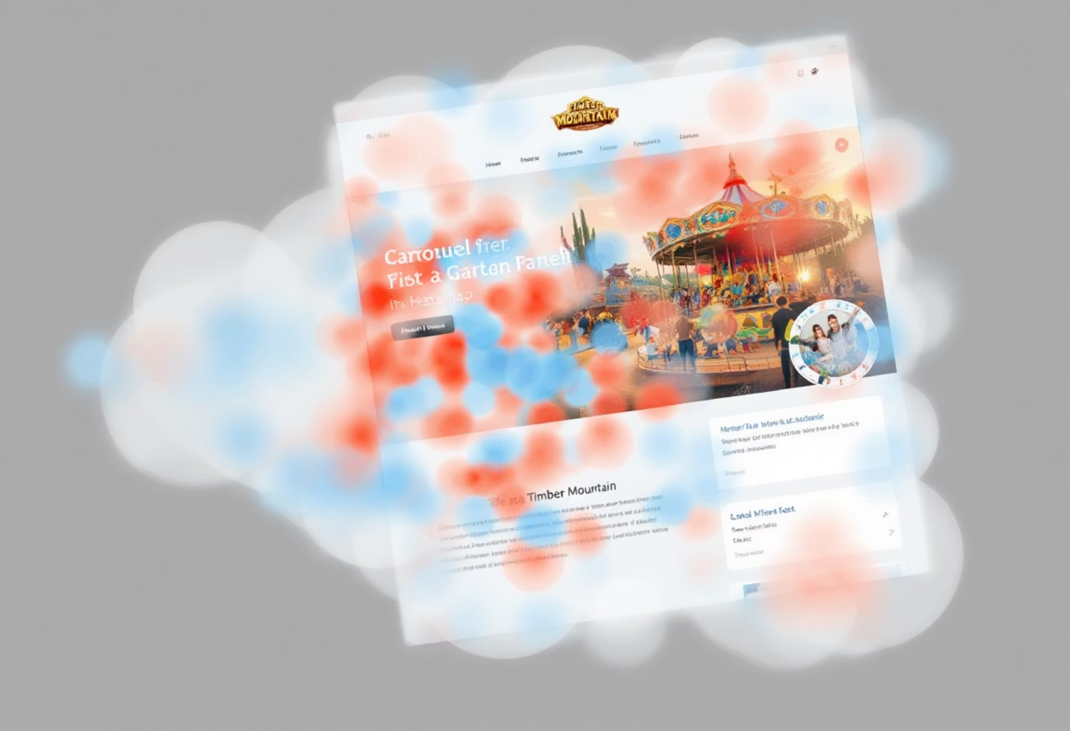
Qualitative Insights
Heat Map Analysis
Eye-tracking shifted dramatically to the carousel motion, but this attention didn't translate to engagement. The Wild Willy planner tile lost 32% of its previous clicks as users' visual focus was diverted.
Session Replay Observations
Users scrolled faster past the carousel than control visitors did past the hero section, indicating a form of "banner blindness" or promotional content avoidance.
"Looks like an ad slideshow; I ignored it."
— Exit poll respondent
User feedback suggested the rotating carousel was perceived as advertising rather than valuable content, triggering learned avoidance behaviors similar to banner blindness.

Slide 10




Conclusions & Next Steps
Rollback Carousel
Static Banner Test
Immediately revert to the control layout for all U.S. traffic to prevent further revenue impact.
Develop A/B test for a slim, single-frame offer banner in the same slot to evaluate messaging effectiveness without motion distraction.
Planner-First Approach
Design Research
Pilot deal-badges inside the Wild Willy planner (e.g., "Save $50" pill on bundle suggestions) to integrate offers within the existing high-engagement path.
Launch a rapid UI research sprint focused on animation tolerance and perceived "ad clutter" specifically for theme-park audience segments.
The carousel test provided valuable insights about our users' interaction patterns. While the original hypothesis was disproven, we've identified several promising alternative approaches to improve bundle visibility without sacrificing the critical Wild Willy planner engagement.

